Slide 1
IMAGE CAPTIONING USING BLIP2 A TRANSFORMER-BASED VISION LANGUAGE APPROACH
BATCH-81 221FA04420-T.Bhargavi
221FA04425-S.Charishma
GUIDE:
Dr.O.BHASKAR

Slide 2
INTRODUCTION
Image captioning is the task of generating meaningful textual descriptions for images by combining computer vision and natural language processing. Recent transformer-based vision–language models have significantly improved caption quality and contextual understanding. BLIP-2 is an efficient framework that connects a vision encoder and a large language model using a lightweight Querying Transformer, enabling accurate and fluent caption generation with reduced training complexity. This approach effectively captures objects, scenes, and their relationships, making it suitable for real-world applications such as assistive technologies and multimedia retrieval.

Slide 3
TOOLS USED
Python
Primary programming language for model development and experimentation.
TensorFlow / PyTorch
Deep learning frameworks for building and training captioning models.
OpenCV / PIL
For image preprocessing and visualization.
Hugging Face Transformers
For using pretrained vision–language models (e.g., CLIP, BLIP, Q-Former).
NumPy & Pandas
For data handling and analysis.
NLTK / SpaCy
For text processing and evaluation.

Slide 4
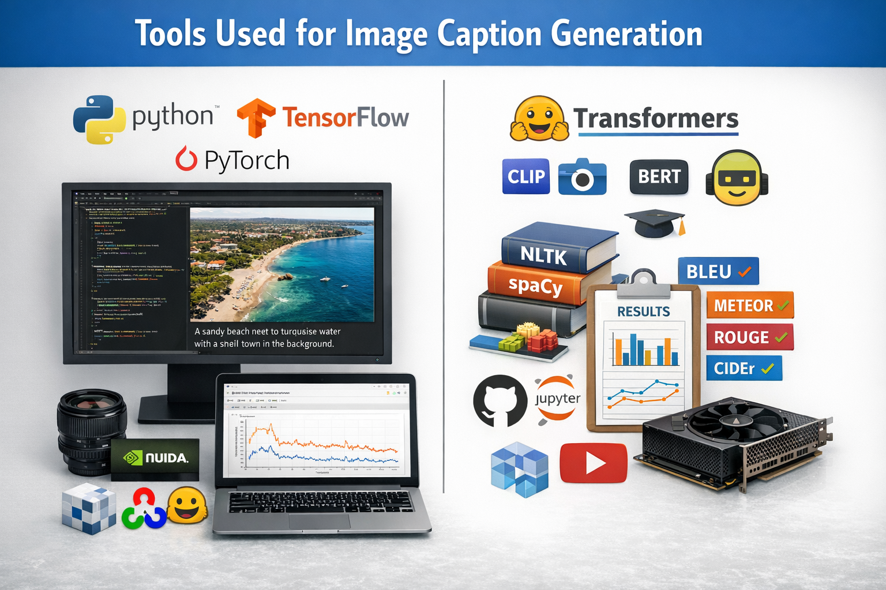
Google Colab / Jupyter Notebook
Development and experimentation environment with GPU support.
CUDA & cuDNN
GPU acceleration for faster training.
Matplotlib / Seaborn
Visualization of training metrics and results.
Git & GitHub
Version control and collaboration.
Datasets
MS-COCO, Flickr8k, Flickr30k, RSICD (for remote sensing), etc.
Evaluation Metrics Tools
BLEU, METEOR, ROUGE, CIDEr evaluation scripts.

Slide 5
APPLICATIONS
Assistive technology for the visually impaired – Provides real-time spoken descriptions of surroundings through mobile phones or smart glasses.
Autonomous vehicles – Describes road scenes, obstacles, traffic signs, and pedestrian activities for safer navigation.
Surveillance and security systems – Automatically summarizes live camera feeds to detect suspicious activities or unusual events.
Social media and content moderation – Generates captions for uploaded images to improve accessibility and content understanding.
Smart robots and service robots – Helps robots understand and describe environments for interaction and task execution.

Slide 6
Healthcare monitoring – Describes medical images or patient activities in real time for faster diagnosis and assistance.
E-commerce platforms – Automatically generates product descriptions from live product images.
Smart home systems – Interprets camera feeds to notify users about events such as visitors, pets, or intrusions.
Disaster management and remote sensing – Describes satellite or drone images to support rapid damage assessment.
Video streaming and broadcasting – Generates live captions to improve accessibility and searchability of visual content.

Slide 7
OBJECTIVES
To automatically generate meaningful and grammatically correct textual descriptions for given images.
To accurately identify and describe important objects, scenes, and their relationships within an image.
To bridge the gap between visual perception and natural language understanding using deep learning models.
To improve semantic consistency and contextual relevance in the generated captions.
To support real-world applications such as assistive technologies for visually impaired users, image retrieval, surveillance, and multimedia indexing.
To enhance model performance in terms of accuracy, fluency, and robustness across diverse image datasets.

Slide 8
LITERATURE SURVEY
S.No | Objective | Dataset(s) Used | Approach / Methodology | Limitations | Accuracy / Performance
1 | Improve remote-sensing image captioning using multi-scale features and semantic memory. | Sydney, UCM, NWPU | CLIP encoder + multi-level feature enhancement + scale-aware attention + semantic memory + Transformer decoder. | Memory less effective on small datasets; sensitive to memory size. | Better CIDEr & BLEU than baselines.
2 | Reduce object omission and misidentification in RS captioning. | UCM, RSICD, NWPU | RS-CLIP patch tokens + hierarchical attention Transformer + text encoder + SCST. | Scene confusion; number-count errors; overfitting risk. | +5.88 BLEU-4, +18.07 CIDEr.
3 | Improve spatial reasoning in RS image captioning. | Sydney, UCM, RSICD | Dual-stream grid & region features + graph attention + spatially aware Transformer. | No explicit object-orientation modeling. | CIDEr ≈ 338–444 range.
4 | Enable semantic image transmission using captions instead of raw images. | MS-COCO | OFA captioning → text transmission → Stable Diffusion XL regeneration → explainable keyword similarity metric. | Weak for cluttered / abstract scenes. | Similarity >0.6; >99% data reduction.

Slide 9
S.No | Objective | Dataset(s) Used | Approach / Methodology | Limitations | Accuracy / Performance
5 | Enhance RS captioning using vision-language pretraining. | RSICD, UCM, Sydney | CLIP grid features + masked text modeling + Transformer encoder–decoder. | Dependent on CLIP feature granularity. | Better than CNN baselines.
6 | Improve semantic relations using concept modeling. | UCM, RSICD, Sydney | CNN + ViT → concept mapping network → global feature enhancement → Transformer. | Higher complexity; depends on concept quality. | Consistent gains over encoder–decoder.
7 | Unify RGB, captions, and multispectral data to solve dataset scarcity. | SkyScript, EuroSAT, synthetic | Qwen2-VL captioning → Stable Diffusion RGB → CycleGAN RGB→multispectral. | Synthetic spectral accuracy limited. | SkyCLIP ≈ 0.73; SAM ≈ 10°.
8 | Survey deep-learning image captioning techniques. | Flickr8k, Flickr30k, MS-COCO | Review of CNN-RNN, LSTM, Transformer, attention methods. | No experiments. | N/A
9 | Improve captioning for culturally complex Thangka images. | Thangka dataset, MS-COCO | Region-guided feature enhancement + CLIP global features + attribute prediction. | Domain-specific; region detection errors possible. | +17.7% BLEU-4; +185.7% CIDEr.

Slide 10
S.No | Objective | Dataset(s) Used | Approach / Methodology | Limitations | Accuracy / Performance
10 | Improve RS image–text retrieval using richer captions. | GLRS, RSICD, RSITMD, UCM | MLLM global + local captions → LLM fusion → fine-tuned RS-CLIP. | Caption hallucination risk. | Better than SoTA retrieval models.
11 | Reduce parameters and computation for CLIP-based captioning in digital media art. | MS-COCO | New Multi-modal Fusion Attention + Transformer-Fusion-CLIP + enhanced beam search. | Still depends on CLIP representations. | 8× faster; >50% fewer parameters.
12 | Improve RS captioning via bidirectional cross-modal interaction. | UCM, Sydney, NWPU | Bidirectional cross-modality Transformer + cyclic joint representation + multi-level feature fusion. | Transformer complexity. | BLEU-1 ≈ 92–95%.
13 | Incorporate object relative size into RS captions. | UCM, Sydney, RSICD + extended sets | Object size estimation + graph construction + GCN + caption generator + SizeNum-METEOR metric. | Needs extra size annotations. | Best on size-aware metrics.
14 | Exploit unlabeled data for semi-supervised RS captioning. | Sydney, UCM, RSICD | CLIP-based caption quality scoring → tri-level pseudo-supervision. | Depends on CLIP alignment quality. | Consistent gains over supervised.

Slide 11
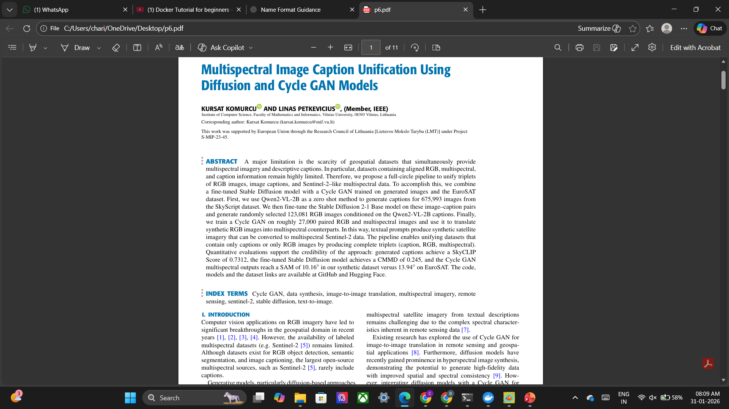
BASE PAPER

Slide 12
CNN (Convolutional Neural Network)
A Convolutional Neural Network (CNN) is a deep learning model specifically designed to process grid-structured data such as images.
It automatically learns spatial features like edges, textures, shapes, and objects using convolution operations.
How CNN Works
Applies convolution filters to extract features
Uses pooling to reduce dimensionality
Learns hierarchical patterns (edges → shapes → objects)

Slide 13
ViT (Vision Transformer)
A Vision Transformer (ViT) is a transformer-based deep learning model that applies self-attention mechanisms to images by treating them as a sequence of patches, similar to words in NLP.
How ViT Works
Divides image into fixed-size patches
Converts patches into embeddings
Uses self-attention to learn relationships between patches
Processes the entire image globally

Slide 14
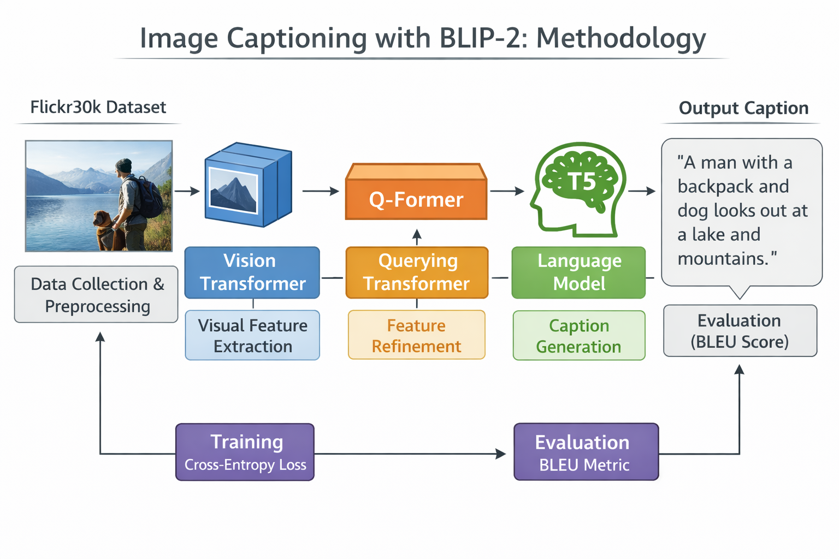
METHODOLOGY

Slide 15
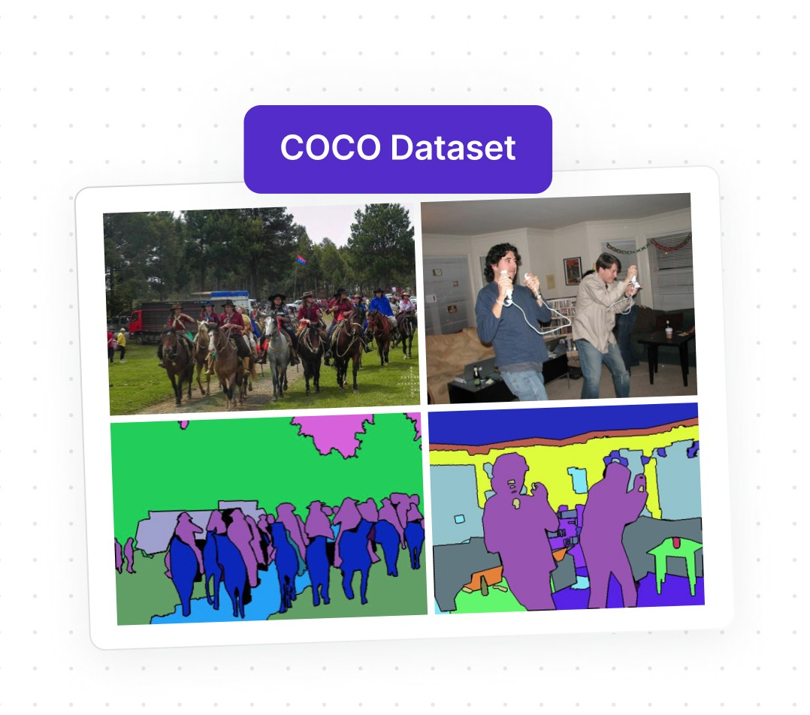
1. MS-COCO Dataset
The MS-COCO (Microsoft Common Objects in Context) dataset is used in this project as the primary data source. It contains a large collection of real-world images with multiple human-annotated captions per image, covering diverse objects, scenes, and interactions. The availability of multiple reference captions makes MS-COCO suitable for training robust image captioning models and for evaluating caption quality using standard metrics.

Slide 16
2. Data Collection and Preprocessing
Images and corresponding captions are collected from the MS-COCO dataset and preprocessed before being fed into the model. Image preprocessing includes resizing and normalization to meet the input requirements of the vision encoder. Captions are tokenized, truncated, and padded to a fixed length to ensure uniform textual input. This preprocessing step enhances model stability and enables efficient batch training.
3. Vision Transformer (Visual Feature Extraction)
A pretrained Vision Transformer (ViT) is used to extract high-level visual features from the input images. The ViT divides each image into fixed-size patches and processes them using self-attention mechanisms, allowing the model to capture global contextual information such as object relationships and scene structure. The resulting visual embeddings represent meaningful semantic information required for caption generation.

Slide 17
4. Q-Former (Querying Transformer)
The Querying Transformer (Q-Former) serves as a bridge between the vision encoder and the language model. It utilizes a set of learnable query tokens that attend to the visual embeddings produced by the Vision Transformer. Through this attention mechanism, the Q-Former selectively extracts task-relevant visual features, reducing redundancy and focusing on information essential for generating accurate captions.
5. Feature Refinement
Within the Q-Former, the extracted visual features undergo refinement to improve their semantic alignment with natural language representations. This refinement process filters out irrelevant visual details and enhances meaningful object-level and contextual information. As a result, the refined features become more suitable for input into the language model, leading to improved caption quality.

Slide 18
6. Language Model (T5)
A pretrained Transformer-based language model, T5, is used for caption generation. The refined visual features from the Q-Former are projected into the language model’s embedding space. The T5 model then generates captions in an autoregressive manner, predicting one word at a time based on the visual context and previously generated words, ensuring grammatical correctness and semantic coherence.
7. Caption Generation
During inference, the trained BLIP-2 model generates captions for unseen images from the MS-COCO dataset. Decoding strategies such as greedy decoding or beam search are employed to produce coherent and meaningful captions. The generated output describes objects, actions, and scene context present in the image in natural language form.

Slide 19
9. Evaluation Using BLEU Score The performance of the image captioning model is evaluated using the BLEU (Bilingual Evaluation Understudy) metric. BLEU measures the similarity between generated captions and reference captions based on n-gram overlap. Higher BLEU scores indicate better accuracy, fluency, and semantic alignment of the generated captions with human descriptions.
8. Training Using Cross-Entropy Loss
The training process optimizes the model using cross-entropy loss, which measures the difference between predicted caption tokens and the ground-truth captions. During training, the vision encoder and language model remain frozen, while only the Q-Former and projection layers are updated. This strategy significantly reduces computational cost while maintaining strong captioning performance.

Slide 20
CONCLUSION
The rapid progress of artificial intelligence has made it possible for machines to not only see but also describe visual content in a meaningful way. Image caption generation has emerged as a powerful technique for connecting visual perception with natural language understanding, enabling intelligent interpretation of images across diverse domains. It improves accessibility, supports automation, and enhances real-time decision-making in applications ranging from assistive systems to autonomous platforms. Although challenges remain in accurately describing complex scenes and subtle contextual details, ongoing advancements in deep learning and vision–language models continue to strengthen the quality and reliability of generated captions.

Slide 21
THANK YOU

